Slide 1
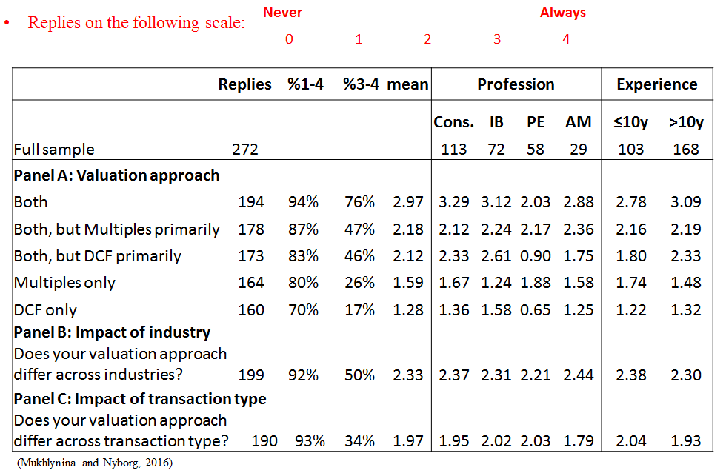
Survey of valuation professionals: Usage of Multiples vs. DCF
© Kjell G. Nyborg
*Cons.: Consulting; IB: Investment; Banking; PE: Private Equity; AM: Asset Management

Slide 2
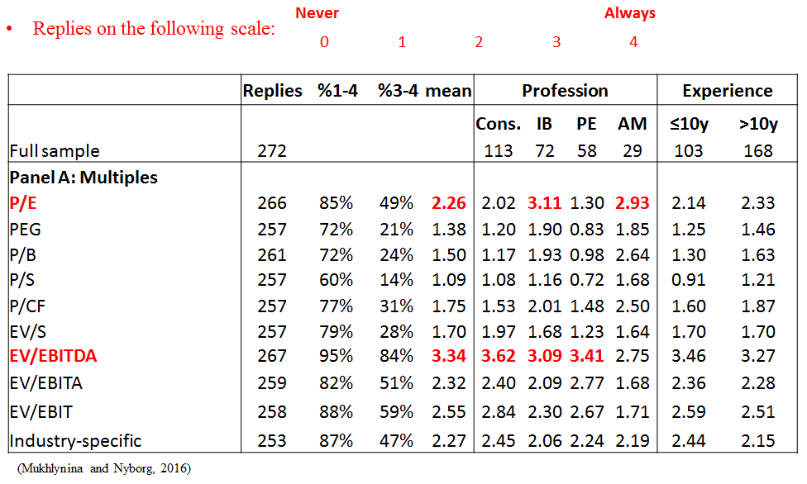
Survey of valuation professionals: Most widely used multiples
© Kjell G. Nyborg

Slide 3
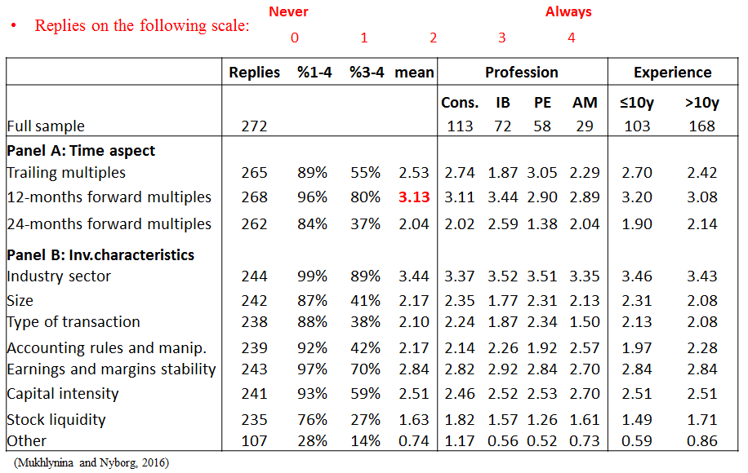
Survey of valuation professionals: Choice of multiples
© Kjell G. Nyborg

Slide 4
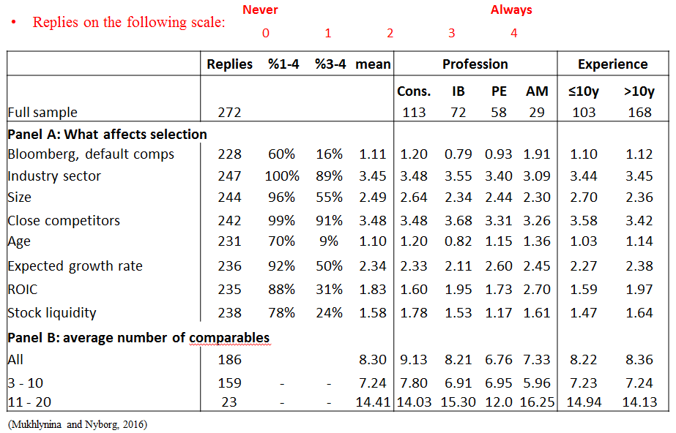
Survey of valuation professionals: Selection of comparables
© Kjell G. Nyborg

Slide 5
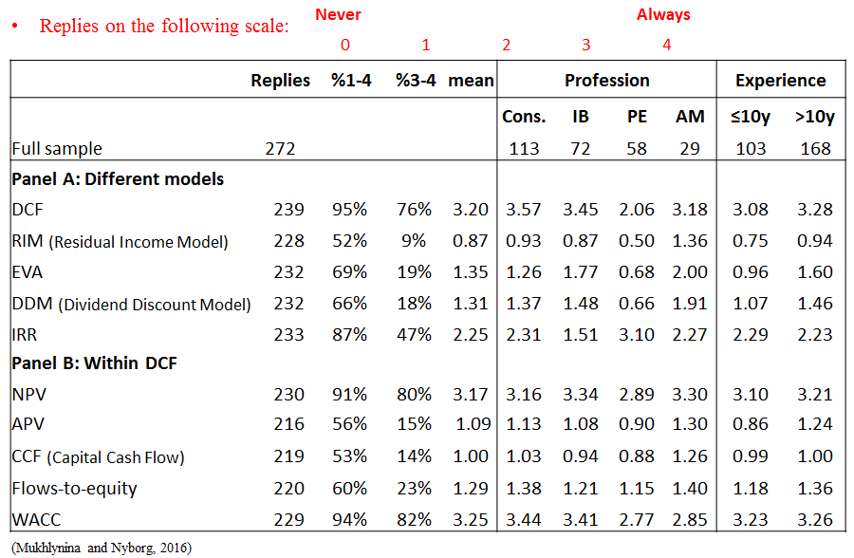
Survey of valuation professionals: Multiperiod models
© Kjell G. Nyborg

Slide 6
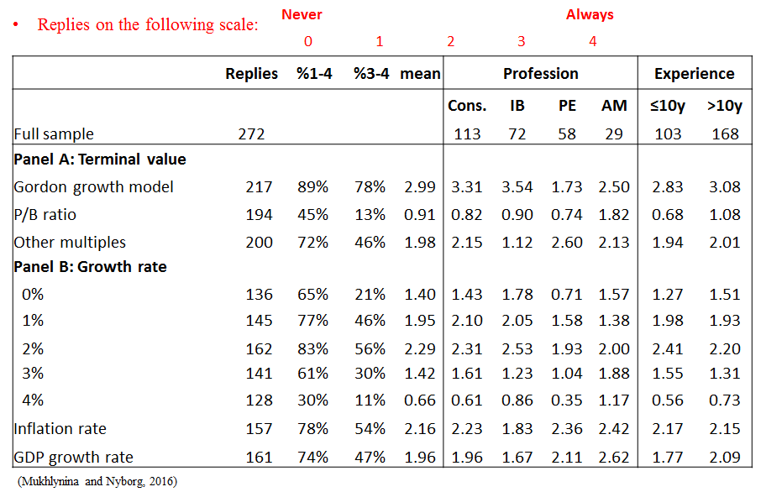
Survey of valuation professionals: Multiperiod model assumptions
© Kjell G. Nyborg

Slide 7
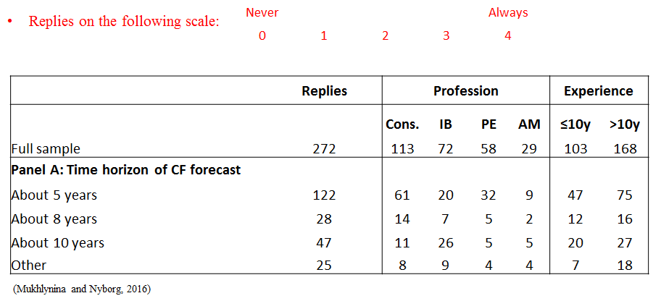
Survey of valuation professionals: Multi-period model assumptions
© Kjell G. Nyborg

Slide 8
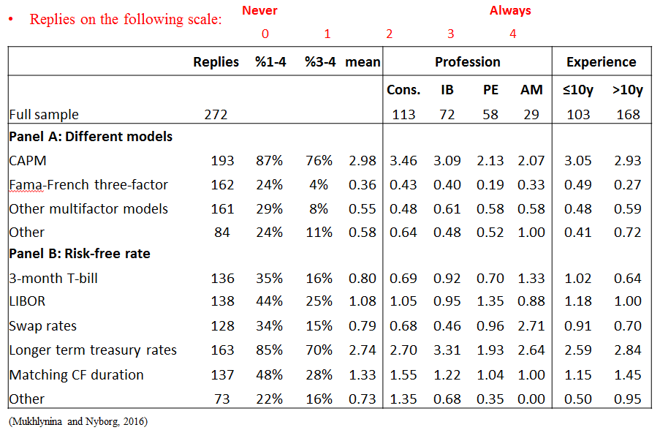
Survey of valuation professionals: Calculating Cost of Equity
© Kjell G. Nyborg

Slide 9
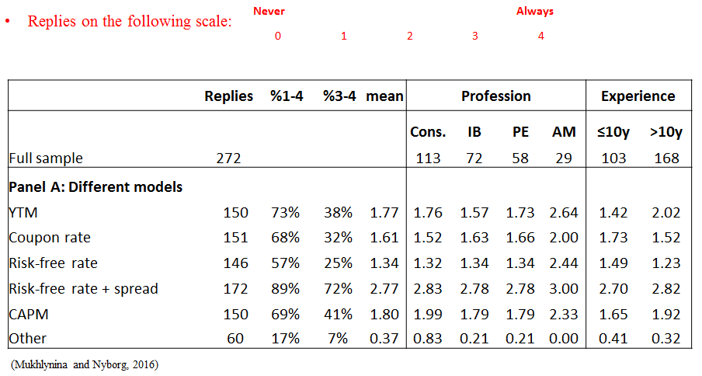
Survey of valuation professionals: Calculating Cost of Debt
© Kjell G. Nyborg

Slide 10
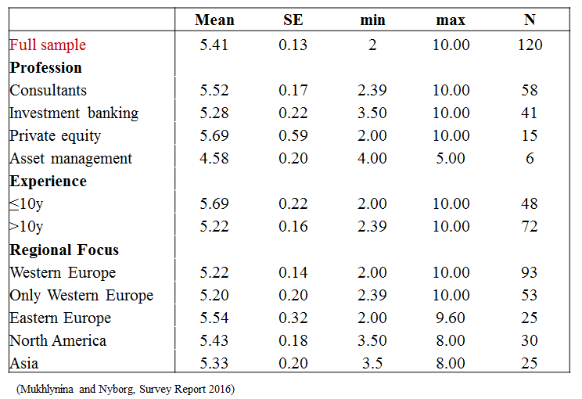
Survey of valuation professionals: Market Risk Premium
© Kjell G. Nyborg

Slide 11
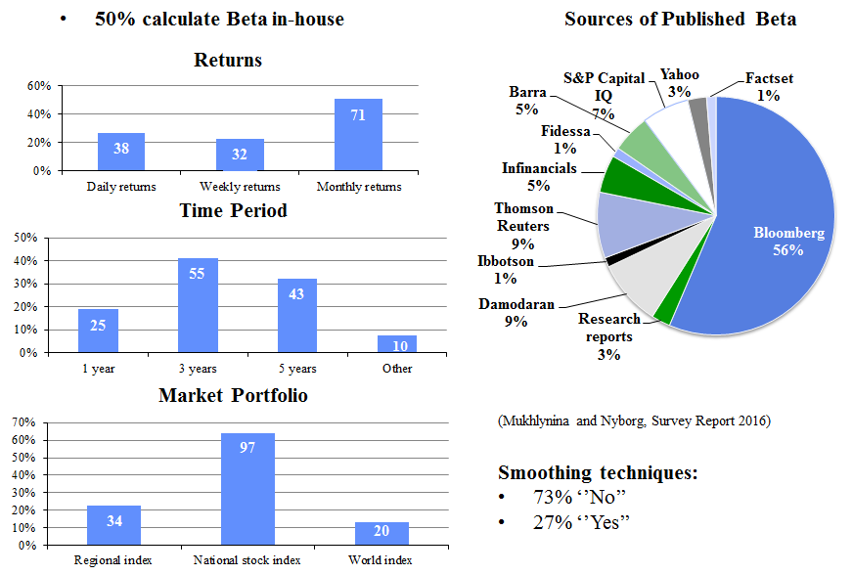
Survey of valuation professionals: Beta calculation
© Kjell G. Nyborg

